Slide 1
History of Cryptography
By Aiden Magali

Slide 2
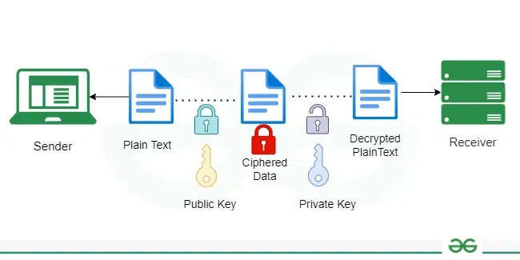
What is Cryptography
The art or practice of writing or solving codes.
Earliest uses of Cryptography date back to the Ancient Rome and Greece.
Has evolved from simple letter shifts to complex mathematical algorithms.
Involves techniques such as encryption, decryption, hashing, and digital signatures.
Plays a critical role in national security, personal privacy, and global commerce.

Slide 3
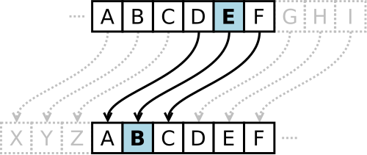
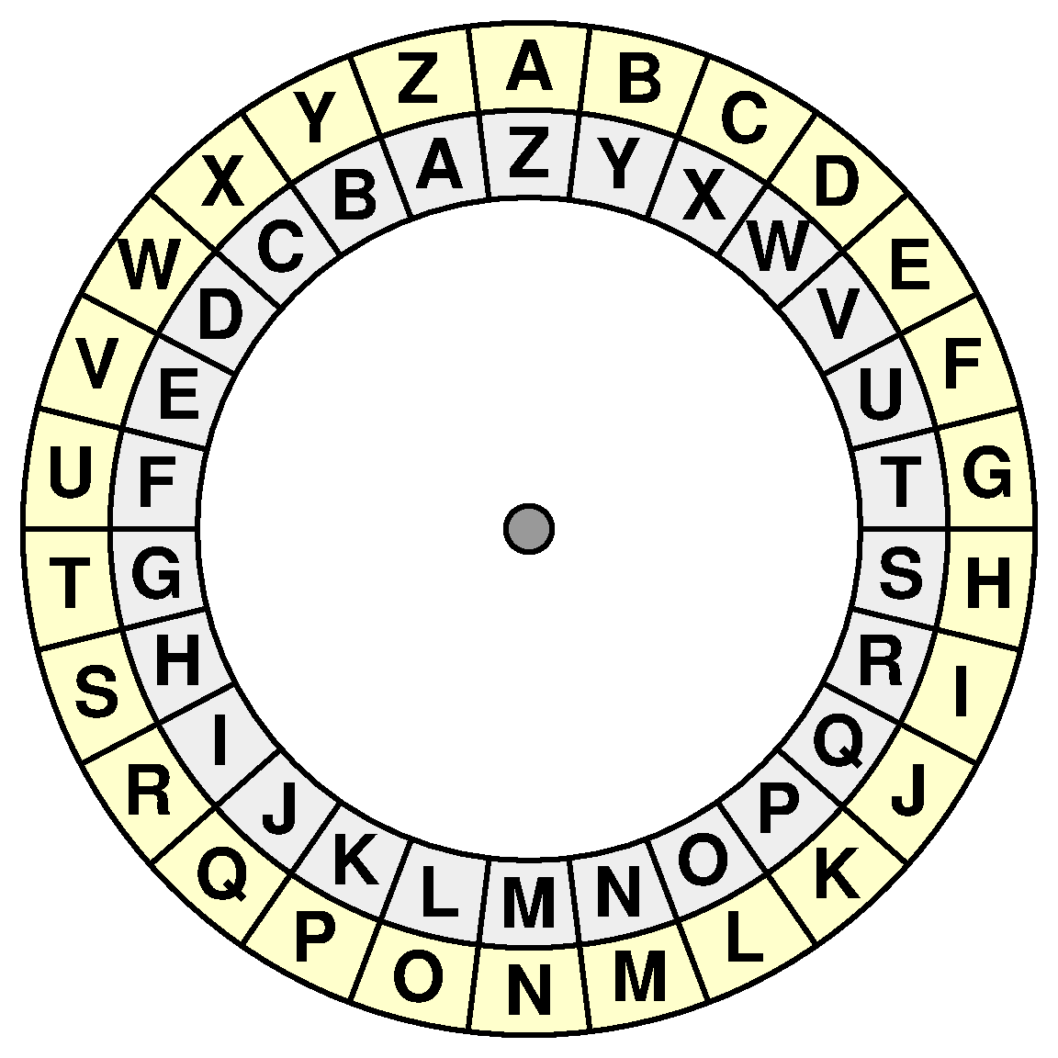
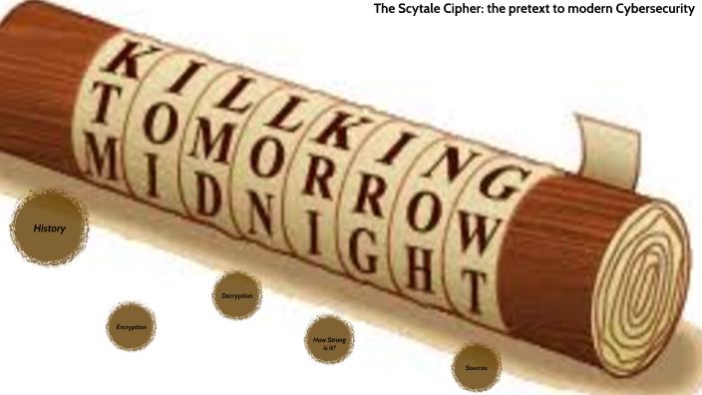
Early Beginnings
Caesar Cipher
Made for military messages across the increasingly large Roman Empire.
Shifted letters by a fixed amount.
Hebrew Atbash Cipher
Protected military, religious, and trade secrets.
Utilized a reverse alphabet Substitution.
Greek Scytale
Worked by rearranging letters rather than substituting them.
Message would be written around a tube and then unwrapped to be sent. Message would need to be warped around an identical tube to be read.

Slide 4
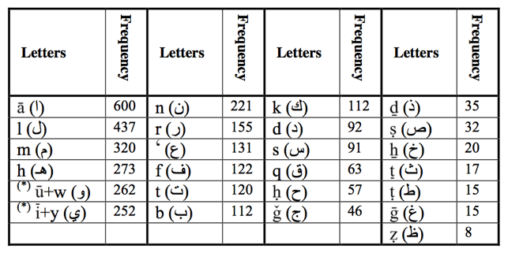
Islamic Golden Age
Al Kindi (9th century) invented a frequency analysis to break substitution ciphers.
This was the first scientific approach to codebreaking.
This shifted cryptography form being a form of art to a type of science.
Also the age where Steganography emerged, which is the act of hiding messages in plain sight.

Slide 5
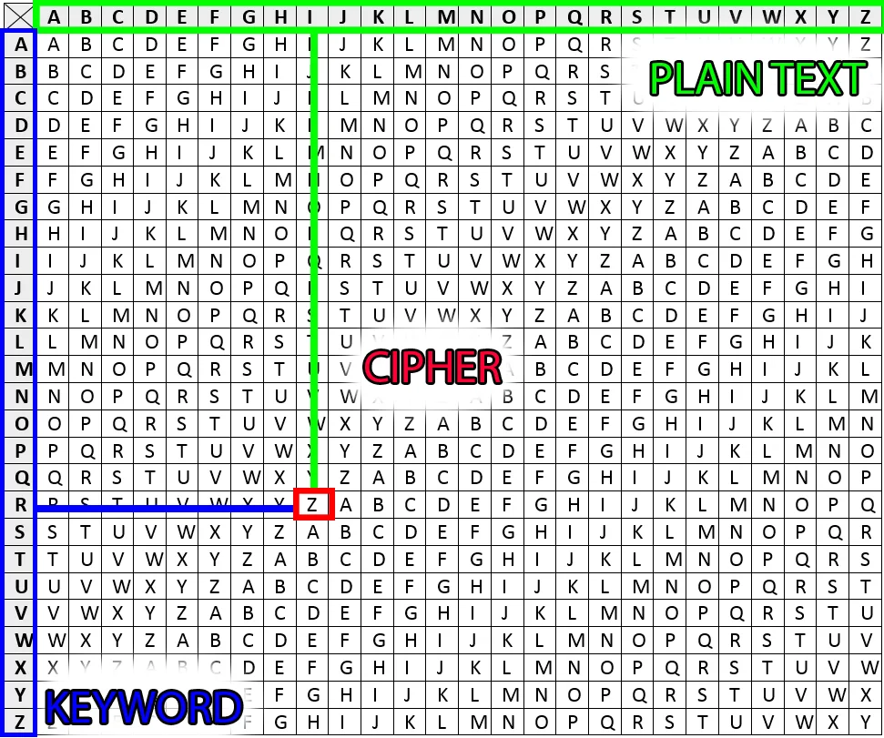
Renaissance
Vigenere Cipher utilized a key to vary letter shifts. (Instead of using fixed shifts like earlier ciphers.
This newer version of a shifting cipher was considered unbreakable at the time.
In this period Cryptography went over mathematical formalization.
Cryptography became political and diplomatic and was utilized in royal courts and espionage.

Slide 6
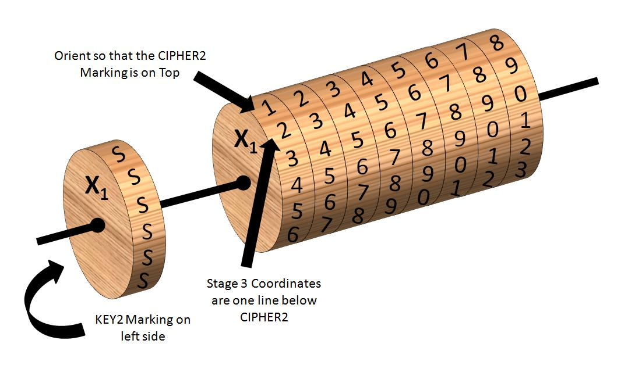
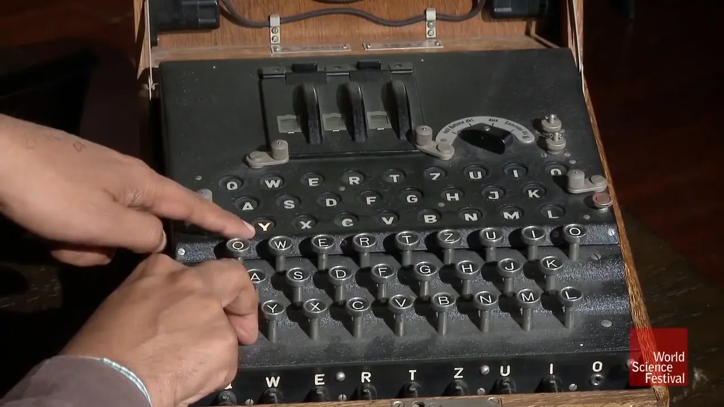
Mechanization
The Jefferson Disk invented by Thomas Jefferson in the 1790s was a machine that utilized rotating disks to encipher and decipher messages.
Rotor Machines were invented utilizing electrical rotors to automate substitution ciphers.
The Enigma Machine invented by Arthur Scherbius was utilized by the German military and was more complex for better encryptions. Was later cracked by Allied efforts and was the centerpiece of WWII cryptography.

Slide 7
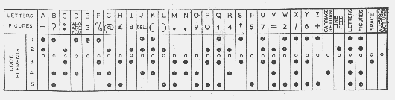
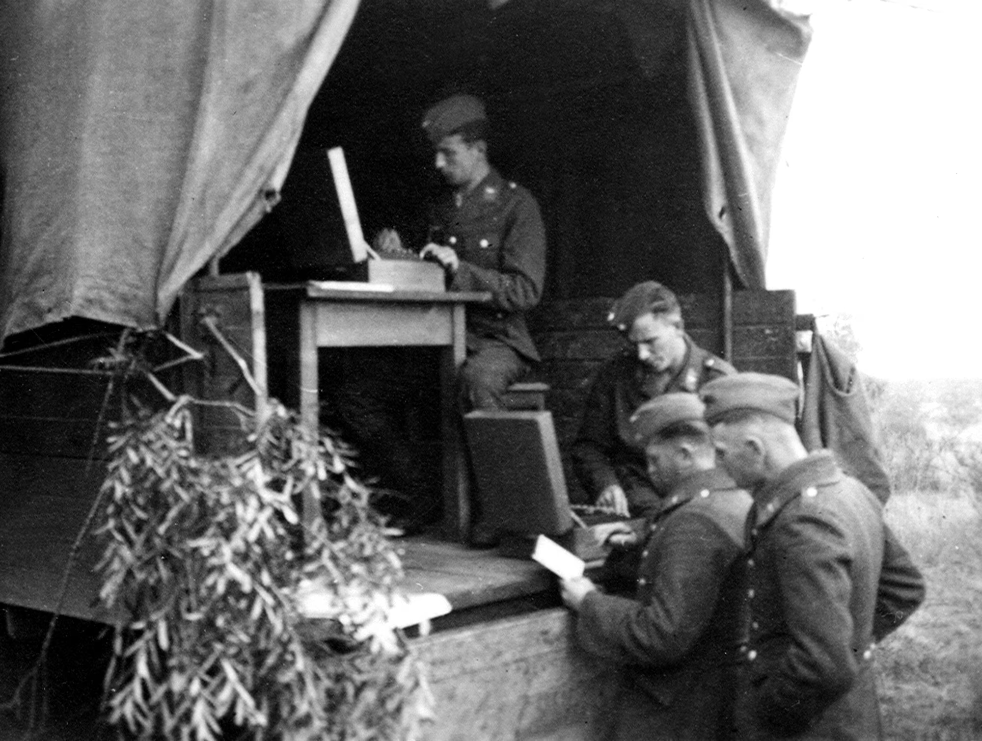
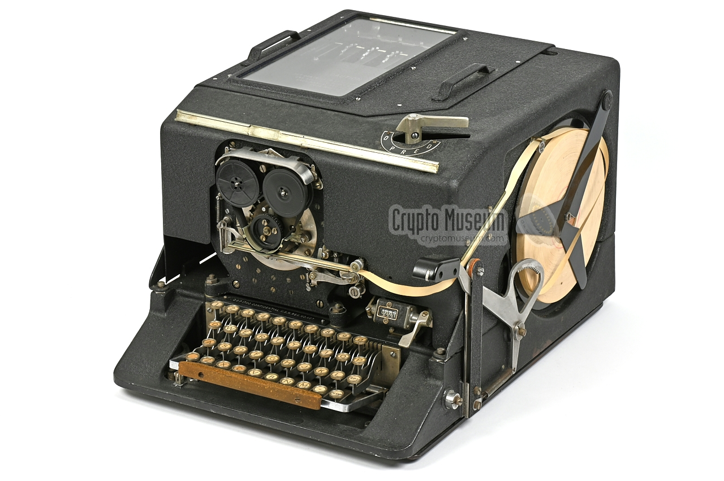
Cryptography in World War II
Both sides of the war had utilized different encryption methods in order to encrypt messages from enemies.
Lorenz Cipher was an early case of digital codebreaking utilized by the Germans.
The SIGABA and Typex were American and British encryption machines and they weren’t broken by the Axis powers.
These machines were utilized throughout the majority of the war.

Slide 8
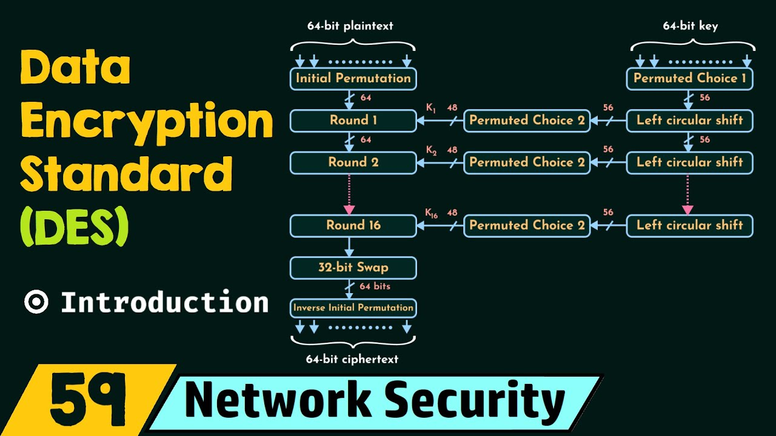
Digital Revolution
The Data Encryption Standard (DES), developed by IBM and adopted by the U.S. National Bureau of Standards, utilized a 56-bit key for symmetric encryption.
This became the first federal encryption standard but was eventually deemed to insecure.
Public Key cryptography, introduced by Whitfield Diffie and Martin Hellman solved the problem of secure key exchange over insecure channels.
It utilized a public key for encryption and a private key for decryption.

Slide 9
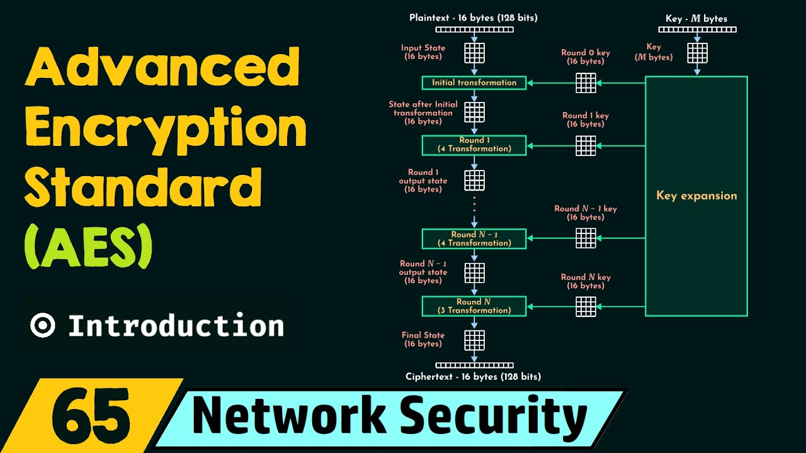
Modern Day
Advanced Encryption Standard (AES) replaced the DES . It uses 256-bit keys for symmetric encryption.
While AES and DES are more advanced than earlier encryption methods, they still use the same key for both encryption and decryption. (Just like earlier methods such as the Caesar cipher)
Its now the global standard for encrypting data at rest and in transit. And its used in everything from Wifi to cloud storage and VPNs.

Slide 10
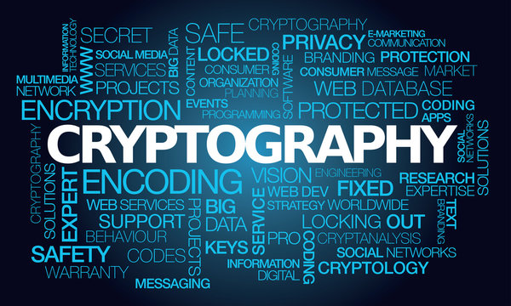
Why it’s so Important
Cryptography helps keep personal data secure from Government secrets to wifi passwords
It allows for safe digital communication without the worry of sensitive information getting out.
It is still improving and evolving to get better every single day.

Slide 11
Cited Sources
Gustavus J. Simmons, History of Cryptography, Britannica.com, 2025
Josh Schneider, History of Cryptography, IBM Think, 2023
National Institute of Standards and Technology (NIST), Cryptography, nist.gov, 2024
Lily Chen and Matthew Scholl, The Cornerstone of Cybersecurity-Cryptographic Standards and a 50 year evolution, NIST Cybersecurity Insights, 2022
Crypto Museum, History of the Enigma, Crypto Museum, 2021
Sir John Dermot Turing, Alan Turing and the Hidden Heroes of Bletchley Park, The National WWII Museum, 2020
Chrissy Gregg, Code Girls: The Untold Story of the AMerican Women Code Breakers of World War II, The National WWII Museum, 2020

